Slide 1
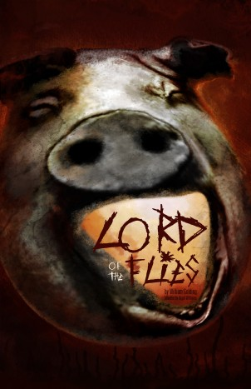
Lord of the flies
English 2201-Ms. Earle

Slide 2
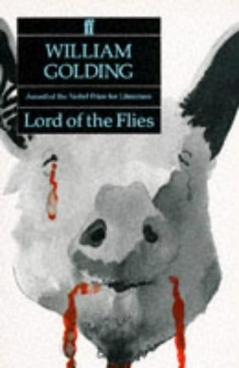
Introduction
Two and a Half Men-
http://www.youtube.com/
watch?feature=endscreen
&NR=1&v=rOCipr_8N6A
Making Predictions-
What do you think this
novel is about?

Slide 3
Simpsons-http://www.youtube.com/watch?v=8duykHFyXKk
Movie Trailer-http://www.youtube.com/watch?v=T45MsH6pwM4

Slide 4
About the Author
William Golding was born on September 19, 1911, in Cornwall, England. After graduating from Oxford, he worked briefly as a theatre actor and director, wrote poetry, and then became a schoolteacher. In 1940, a year after England entered World War II, Golding joined the Royal Navy, where he served in command of a rocket-launcher and participated in the invasion of Normandy.

Slide 5
William Golding-1911-1993

Slide 6
Golding’s experience in World War II had a profound effect on his view of humanity and the evils of which it was capable. After the war, Golding resumed teaching and started to write novels. His first and greatest success came with Lord of the Flies (1954), which ultimately became a bestseller in both Britain and the United Golding died in 1993, one of the most acclaimed writers of the second half of the twentieth century.

Slide 7
Introduction to the Novel
Lord of the Flies tells the story of a group of English schoolboys stranded on a tropical island after their plane is shot down during a war. Though the novel is fictional, its exploration of the idea of human evil is at least partly based on Golding’s experience with the real-life violence and brutality of World War II. Free from the rules and structures of civilization and society, the boys on the island in Lord of the Flies descend into savagery. As the boys splinter into factions, some behave peacefully and work together to maintain order and achieve common goals, while others rebel and seek only anarchy and violence. In his portrayal of the small world of the island, Golding paints a broader portrait of the fundamental human struggle between the civilizing instinct—the impulse to obey rules, behave morally, and act lawfully—and the savage instinct—the impulse to seek brute power over others, act selfishly, scorn moral rules, and indulge in violence.

Slide 8
Golding employs a relatively straightforward writing style in Lord of the Flies, one that avoids highly poetic language, lengthy description, and philosophical interludes. Much of the novel is allegorical, meaning that the characters and objects in the novel are infused with symbolic significance that conveys the novel’s central themes and ideas. In portraying the various ways in which the boys on the island adapt to their new surroundings and react to their new freedom, Golding explores the broad spectrum of ways in which humans respond to stress, change, and tension.

Slide 9
Survivor Activity
In groups of four, students will make a survival plan. As a class, the groups discuss and defend their decisions.
Handout

Slide 10
Chapter One-The Sound of the Shell
Notes: Third person omniscient point of view and foreshadowing
Vocab
Journal Writing:
Students choose 1 of 2 topics:
i) You have just arrived on the island. What will you do for the first week?
ii) If you were on the island which 3 personal items would you bring and why? Which people in your life would you bring?

Slide 11
Chapter One
The opening chapter begins with two boys, Piggy and Ralph, making their way through the jungle. We learn, through their dialogue, that they had been travelling in an airplane with a group of British school children. The plane had presumably been shot down and crashed on a an island in the Pacific. It is hinted that the rest of the world is at war, and that most of it has been destroyed by nuclear attacks -- possibly explaining that the children were being evacuated.
A storm has come and gone, washing the wreckage away. Ralph and Piggy meet and revel at the prospect that they are alone on a tropical island with no adults. They make their way to the beach where they find a large conch shell. Using the shell as a horn, Ralph summons any other children that may be on the island. They begin to come from the jungle and Piggy tries to take names.

Slide 12
Along the beach two marching files of black-clad children approach. This is the first we see of Jack Merridew (who, oddly enough is the only child, besides Percival, whose last name we will learn). Piggy is immediately singled out by the group and made fun of. The children do not like him and never will.
Being children, and at first thinking that survival is a game to be played and that rescue is inevitable, they decide to vote for a chief "to decide things." It is obvious the only two contenders are Jack and Ralph. Ralph is voted in; he had possession of the conch -- already magical in quality to those present -- and seemed the most able. Jack's black-clad choir are designated as hunters upon Jack's insistence -- already revealing his need to hunt and kill.

Slide 13
Ralph's first decision as chief is to send a party out to investigate whether or not they are really on an island. Himself, Jack, and Simon leave to scale the mountain. As they climb the pink granite, they take time to have fun and roll a large boulder off the edge to watch it be destroyed "like a bomb." This need to destroy begins with this innocent rock-rolling and will eventually culminate with the killing of a sow, Simon, Piggy and the hunting of Ralph later in the story.
They reach the summit and indeed discover they are on an island, apparently uninhabited. A new friendship develops between Ralph and Jack. They savour the "right of domination," and Jack comments about how they will have fun and hunt "until they fetch us." Jack believes rescue is inevitable and these thoughts will contribute to his behaviour later in the novel.
On the descent down the mountain they discover a piglet caught in the underbrush. Jack unsheathes his knife and raises it, ready to let fly -- but he cannot. His current nature will not let him spill blood -- but this will change. He is embarrassed and promises that next time he will kill.

Slide 14
Notes
Lord of the Flies dramatizes the conflict between the civilizing instinct and the barbarizing instinct that exist in all human beings. The artistic choices Golding makes in the novel are designed to emphasize the struggle between the ordering elements of society, which include morality, law, and culture, and the chaotic elements of humanity’s savage animal instincts, which include anarchy, bloodlust, the desire for power, amorality, selfishness, and violence. Over the course of the novel, Golding portrays the rise and swift fall of an isolated, makeshift civilization, which is torn to pieces by the savage instincts of those who compose it.

Slide 15
In this first chapter, Golding establishes the parameters within which this civilization functions. To begin with, it is populated solely with boys—the group of young English schoolboys shot down over the tropical island where the novel takes place. The fact that the characters are only boys is significant: the young boys are only half formed, perched between civilization and savagery and thus embodying the novel’s central conflict. Throughout the novel, Golding’s foundation is the idea that moral and societal constraints are learned rather than innate—that the human tendency to obey rules, behave peacefully, and follow orders is imposed by a system that is not in itself a fundamental part of human nature. Young boys are a fitting illustration of this premise, for they live in a constant state of tension with regard to the rules and regulations they are expected to follow. Left to their own devices, they often behave with instinctive cruelty and violence. In this regard, the civilization established in Lord of the Flies—a product of preadolescent boys’ social instincts—seems endangered from the beginning.

Slide 16
In Chapter 1, the boys, still unsure of how to behave with no adult presence overseeing them, largely stick to the learned behaviours of civilization and order. They attempt to re-create the structures of society on their deserted island: they elect a leader, establish a division of labour, and set about systematically exploring the island. But even at this early stage, we see the danger that the boys’ innate instincts pose to their civilization: the boys cruelly taunt Piggy, and Jack displays a ferocious desire to be elected the group’s leader.

Slide 17
Throughout Lord of the Flies, Golding makes heavy use of symbols to present the themes and dramatic conflicts of the novel. In this chapter, for instance, Golding introduces the bespectacled Piggy as a representative of the scientific and intellectual aspects of civilization. Piggy thinks critically about the conch shell and determines a productive use for it—summoning the other boys to the beach. The conch shell itself is one of the most important symbols in the novel. The conch shell represents law, order, and political legitimacy, as it summons the boys from their scattered positions on the island and grants its holder the right to speak in front of the group. Later in the novel, Golding sharply contrasts the conch shell with another natural object—the sinister pig’s head known as the Lord of the Flies, which comes to symbolize primordial chaos and terror.

Slide 18
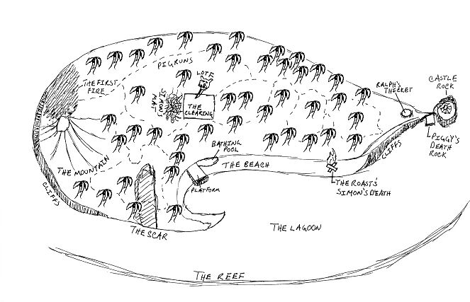
Chapter Two-Fire on the Mountain
Draw a map of the island. Include color, labels, a legend or key, and details.

Slide 20
Reflect on the survival activity from last day. Individually, write a list of 10 rules in order of importance for your island inhabitants. Discuss as a class.
Journal. Describe the island without looking at the book.

Slide 21
Chapter Two
Later that evening, Ralph calls another meeting by blowing on the conch. He conveys to the group of kids that they are on an island with no grown ups (The number of kids is not fully known -- and will never be known -- but we assume it is around thirty. Most of them are very small, possibly five or six years old and are called "littluns." The rest are near Ralph's age, possibly twelve years old.) Also, Jack insists on having an army of hunters and begins talking excitedly about the piglet.
At this time Ralph lays down some rules. First, when someone wishes to speak at an assembly he must hold the conch shell. No one is allowed to interrupt the holder of the conch except Ralph. The conch begins to symbolize the organization of society and the rules that such a society must uphold to function.

Slide 22
They speak excitedly about their new temporary home, how it is a "good island" and how much fun it will be. Then, a littlun with a large birthmark on his face steps forward to speak. He is given the conch shell. The child tells of a "beastie" that he saw in the dark, lurking on the island. It looked like a snake and is the first manifestation of the Beast. It is argued whether or not such a beast could live on a small island. Ralph doesn't think so, but nonetheless he feels himself "facing something ungraspable." Jack says his hunters will kill the beast if, indeed, it does exist.
Ralph then introduces another prevailing symbol of the novel: the signal fire. He will make it paramount that a signal fire be maintained to aid in their rescue. At mention of creating such a fire at the top of the mountain, the children become excited and rush off, lead by Jack, to the summit to see if they can complete such a task -- to really prove they can make it on their own. Ralph follows, and Piggy comments that they are acting like "a crowd of kids." This is ironic, because they are a crowd of kids. It shows how Piggy is set apart from the group; that he is more mature and does not throw caution to the wind as Jack does.

Slide 23
A huge pile of gathered wood is made on the top of the mountain. Jack, against Piggy's protest, grabs his specs to light the fire with and soon it is blazing. Piggy comments that the effort was wasted because the fire produced little smoke. Jack begins arguing with him. Piggy tells Jack that he has the conch, thus he should not be interrupted, but Jack says, "The conch doesn't count on top of the mountain, so you shut up." Jack is beginning to dislike the rules of the conch.
The group of hunters are divided up to take shifts keeping the fire going. It is then noticed that the sparks from the now-dead fire have ignited half the forest below the mountain. Piggy speaks out against the group's immaturity. He tells them that they ought to be more responsible, they don't even know how many kids are on the island. Jack argues against him. Piggy points to the inferno and asks where the boy with the birthmark is. Nobody knows he has been killed by the fire, by the lack of responsibility, the rampant adventure and maybe something else that is present in the boys. He is the first to die and the boys can only stare at the fire, marvelling with horror at what they have done.

Slide 24
Notes
The conflict between the instincts of civilization and savagery emerges quickly within the group: the boys, especially Piggy, know that they must act with order and forethought if they are to be rescued, but the longer they remain apart from the society of adults, the more difficult it becomes for them to adhere to the disciplined behaviour of civilization. In Chapter 1, the boys seem determined to re-create the society they have lost, but as early as Chapter 2,their instinctive drive to play and gratify their immediate desires undermines their ability to act collectively. As a result, the signal fire nearly fails, and a young boy apparently burns to death when the forest catches fire. The constraints of society still linger around the boys, who are confused and ashamed when they learn the young boy is missing—a sign that a sense of morality still guides their behaviour at this point.

Slide 25
Golding’s portrayals of the main characters among the group of boys contributes to the allegorical quality of Lord of the Flies, as several of the boys stand for larger concepts. Ralph, the protagonist of the novel, stands for civilization, morality, and leadership, while Jack, the antagonist, stands for the desire for power, selfishness, and amorality. Piggy represents the scientific and intellectual aspects of civilization, as his glasses—a symbol of rationality and intellect—enable the boys to light fires. Already the boys’ savage instincts lead them to value strength and charisma above intelligence: although Piggy has a great deal to offer the boys’ fledgling civilization, they see him as a whiny weakling and therefore despise him and refuse to listen to him, even when his ideas are good. For instance, when Piggy suggests that the boys find a way to improve their chances of being rescued, they ignore him; only when the stronger and more charismatic Ralph suggests the same thing do they agree to make the signal fire.

Slide 26
Apart from the boys themselves, the signal fire and the “beastie” also carry symbolic significance. The signal fire serves as a barometer for the boys’ interest in maintaining ties to civilization: as long as it burns, they retain some hope that they will be rescued and returned to society, but as they become increasingly obsessed with power and killing, they lose interest in the fire. When the fire ultimately burns out, the boys’ disconnection from the structures of society is complete. Meanwhile, the beast the young boy claims to have seen also emerges as an important symbol in the novel. At this point, the beast is merely an idea that frightens some of the boys. But as the novel progresses, all the boys tacitly accept the beast’s existence. The beast comes to represent the instincts of power, violence, and savagery that lurk within each human being.

Slide 27
Chapter Three: Huts on the Beach
Show photos. Take a poll of how many people would choose each place as a Survivor setting. As a class, make a list of words on the board to describe each setting. Have students examine their words. Do they have negative or positive connotations?

Slide 28
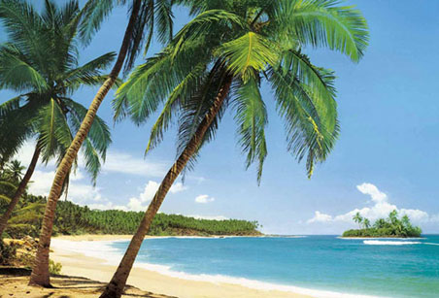
1.Tropical Island

Slide 29
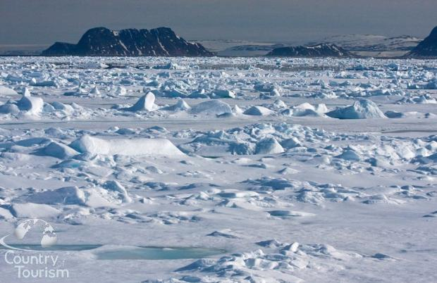
2.The North Pole

Slide 30
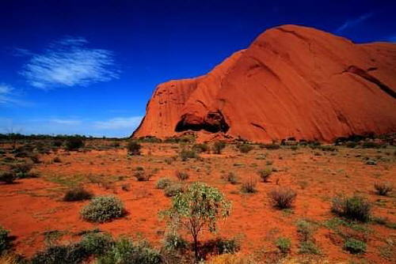
3.The Austrailan Outback

Slide 31
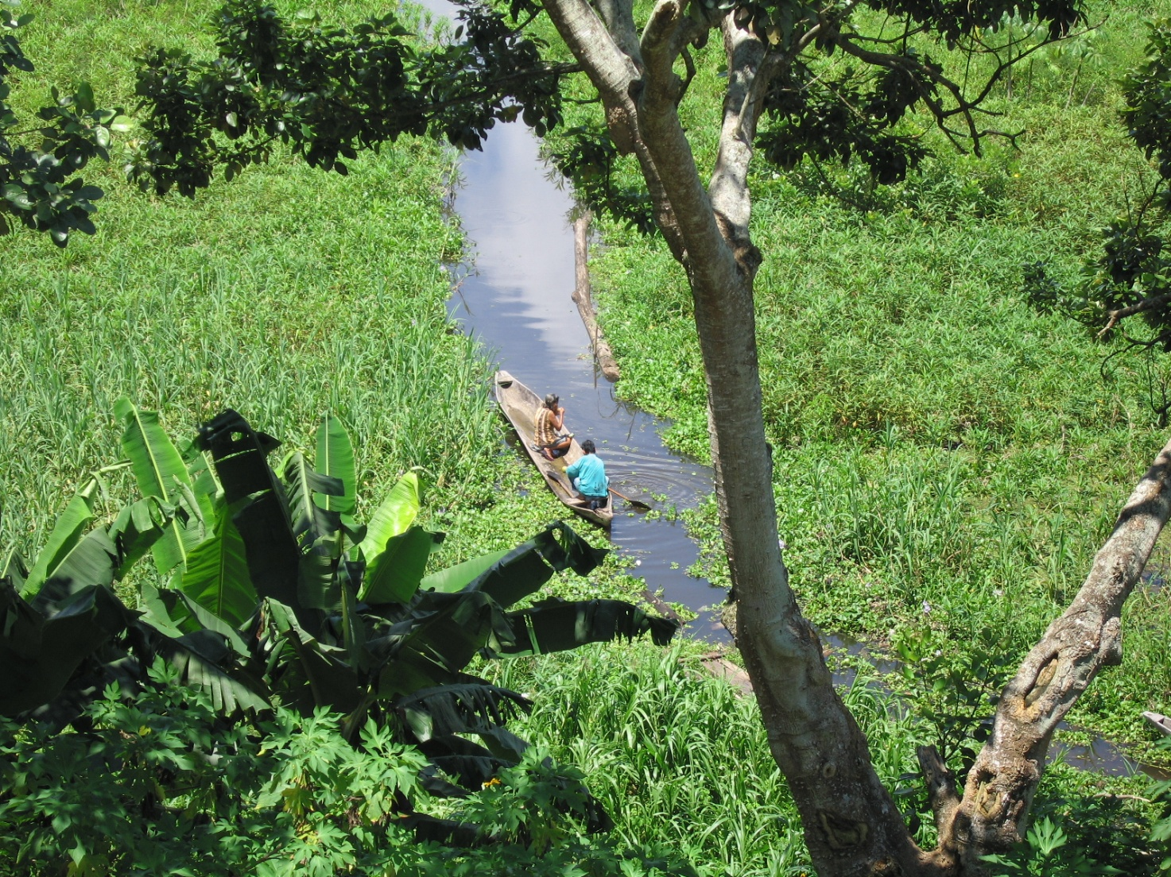
4.The Amazon Jungle

Slide 32
5.The Desert

Slide 33
Notes: Character symbolism and imagery.
Journal.
i) Good vs. Evil
ii)Why did you choose the environment you chose for potential Survivor?
Activity-Making Rules (handout)

Slide 34
Chapter Three
The chapter begins many days, possibly weeks, after the fire on the mountain. Jack is hunting for pigs and has become good at tracking them, but has not killed one as yet. He comes back to the beach where Ralph and Simon are trying to build a hut. Two rickety huts have already been constructed and this last one is not turning out so well. Ralph complains to Jack how the kids don't help; they are bathing or eating fruit in the forest instead. This seems to be a trend with every project they try to accomplish -- a project is proposed at a meeting and they work hard for a little while, but never see it through to completion.
Jack and Ralph have a small argument about whether building huts is more important than hunting. This is the first of many disputes they will have. The subject of the beastie comes up again. Many of the littluns are frightened of it, which is why they are building huts. Jack comments that when he is alone hunting he feels he is, "not hunting, but being hunted... As though something is behind you all the time in the jungle."

Slide 35
Jack has a sudden insight as to where the pigs hide during the day. Ralph continues to badger him about the fact that keeping up the signal fire is more important than hunting, but Jack doesn't seem to think that way. The two boys are beginning to dislike each other. They go to the bathing pool, where, "...the shouting and splashing and laughing were only just sufficient to bring them together again."
Simon wanders into the jungle, helps the littluns pick fruit, and then wanders off further, finding a clearing. There is a thick mat of creepers that grow here. He climbs under them where it is cool and dark and stays there until night fall.

Slide 36
Notes
The personal conflict between Ralph and Jack mirrors the overarching thematic conflict of the novel. The conflict between the two boys brews as early as the election in Chapter 1 but remains hidden beneath the surface, masked by the camaraderie the boys feel as they work together to build a community. In this chapter, however, the conflict erupts into verbal argument for the first time, making apparent the divisions undermining the boys’ community and setting the stage for further, more violent developments. As Ralph and Jack argue, each boy tries to give voice to his basic conception of human purpose: Ralph advocates building huts, while Jack champions hunting. Ralph, who thinks about the overall good of the group, deems hunting frivolous. Jack, drawn to the exhilaration of hunting by his bloodlust and desire for power, has no interest in building huts and no concern for what Ralph thinks. But because Ralph and Jack are merely children, they are unable to state their feelings articulately.

Slide 37
At this point in the novel, the conflict between civilization and savagery is still heavily tilted in favour of civilization. Jack, who has no real interest in the welfare of the group, is forced to justify his desire to hunt rather than build huts by claiming that it is for the good of all the boys. Additionally, though most of the boys are more interested in play than in work, they continue to re-create the basic structures of civilization on the island. They even begin to develop their own language, calling the younger children “littluns” and the twins Sam and Eric “Samneric.”

Slide 38
Simon, meanwhile, seems to exist outside the conflict between Ralph and Jack, between civilization and savagery. We see Simon’s kind and generous nature through his actions in this chapter. He helps Ralph build the huts when the other boys would rather play, indicating his helpfulness, discipline, and dedication to the common good. Simon helps the littluns reach a high branch of fruit, indicating his kindness and sympathy—a sharp contrast to many of the older boys, who would rather torment the littluns than help them. When Simon sits alone in the jungle glade marveling at the beauty of nature, we see that he feels a basic connection with the natural world.

Slide 39
On the whole, Simon seems to have a basic goodness and kindness that comes from within him and is tied to his connection with nature. All the other boys, meanwhile, seem to have inherited their ideas of goodness and morality from the external forces of civilization, so that the longer they are away from human society, the more their moral sense erodes. In this regard, Simon emerges as an important figure to contrast with Ralph and Jack. Where Ralph represents the orderly forces of civilization and Jack the primal, instinctual urges that react against such order, Simon represents a third quality—a kind of goodness that is natural or innate rather than taught by human society. In this way, Simon, who cannot be categorized with the other boys, complicates the symbolic structure of Lord of the Flies.

Slide 40
Chapter Four Painted Faces and Long Hair
Show picture of mask and short article. Discuss use of mask and transformation.
Students choose characters to design masks for. Draw masks.
Journals. Students justify their design and color choices.
Notes: Psychology/human behaviour-group mentality and anonymity.
Colors of Jack’s mask, same as Nazi flag-power of color scheme.

Slide 41
Chapter Four
Roger and Maurice are walking through a group of littluns, kicking over the things they've made in the sand. They split off, and Roger hides behind a palm tree watching a littlun playing by the water. He begins throwing rocks at the littlun, but he aims to miss, because "the taboos of the old world" are still with him.
Jack comes up behind Roger and asks him to come watch as he puts on a "mask" of painted camouflage in order to hunt pigs better. As Jack smears the clay on his face, the mask is "...a thing on its own, behind which Jack hid, liberated from shame and self-consciousness." The mask allows Jack to not worry about rescue and what he knows is right. Behind it he can do what he likes.
Later, Ralph and the rest of the boys are swimming in the bathing pool and smoke is spotted on the horizon. Ralph looks to the mountain top, but the signal fire has gone out. Running up to the summit, with the others following, Ralph reaches the top and the fire is dead, the watchers absent from duty.

Slide 42
Jack and a crowd of hunters move up to the summit, carrying a dead pig. The hunters are excited about their first kill and begin to explain it all to Ralph. None of them care that the fire had gone out, it was not important to them; all they can talk about is the hunt and the kill. When Ralph tells them a ship passed the island they fall silent. Jack tries to make excuses, and during Piggy's protests and lecturing Jack punches him and he falls to the ground. His specs go flying and one lens breaks -- the lenses that made the fire possible are now broken by Jack. Jack apologizes about the fire, but Ralph does not accept.
The fire is re-lit and the pig is roasted. Jack hands out portions of meat to all the boys except Piggy. Simon gives his portion to Piggy and Jack can't stand it. The tension is broken and the story of the hunt is re-enacted by the boys. Maurice pretends to be a pig, while the rest dance and chant around him. This is the first time the "dance" is preformed. Ralph tells them all that he is calling an assembly even though it is dark out.

Slide 43
Notes
At this point in the novel, the group of boys has lived on the island for some time, and their society increasingly resembles a political state. Although the issue of power and control is central to the boys’ lives from the moment they elect a leader in the first chapter, the dynamics of the society they form take time to develop. By this chapter, the boys’ community mirrors a political society, with the faceless and frightened littluns resembling the masses of common people and the various older boys filling positions of power and importance with regard to these underlings. Some of the older boys, including Ralph and especially Simon, are kind to the littluns; others, including Roger and Jack, are cruel to them. In short, two conceptions of power emerge on the island, corresponding to the novel’s philosophical poles—civilization and savagery. Simon, Ralph, and Piggy represent the idea that power should be used for the good of the group and the protection of the littluns—a stance representing the instinct toward civilization, order, and morality. Roger and Jack represent the idea that power should enable those who hold it to gratify their own desires and act on their impulses, treating the littluns as servants or objects for their own amusement—a stance representing the instinct toward savagery.

Slide 44
As the tension between Ralph and Jack increases, we see more obvious signs of a potential struggle for power. Although Jack has been deeply envious of Ralph’s power from the moment Ralph was elected, the two do not come into open conflict until this chapter, when Jack’s irresponsibility leads to the failure of the signal fire. When the fire—a symbol of the boys’ connection to civilization—goes out, the boys’ first chance of being rescued is thwarted. Ralph flies into a rage, indicating that he is still governed by desire to achieve the good of the whole group. But Jack, having just killed a pig, is too excited by his success to care very much about the missed chance to escape the island. Indeed, Jack’s bloodlust and thirst for power have overwhelmed his interest in civilization. Whereas he previously justified his commitment to hunting by claiming that it was for the good of the group, now he no longer feels the need to justify his behaviour at all. Instead, he indicates his new orientation toward savagery by painting his face like a barbarian, leading wild chants among the hunters, and apologizing for his failure to maintain the signal fire only when Ralph seems ready to fight him over it.

Slide 45
The extent to which the strong boys bully the weak mirrors the extent to which the island civilization disintegrates. Since the beginning, the boys have bullied the whiny, intellectual Piggy whenever they needed to feel powerful and important. Now, however, their harassment of Piggy intensifies, and Jack begins to hit him openly. Indeed, despite his position of power and responsibility in the group, Jack shows no qualms about abusing the other boys physically. Some of the other hunters, especially Roger, seem even crueler and less governed by moral impulses. The civilized Ralph, meanwhile, is unable to understand this impulsive and cruel behaviour, for he simply cannot conceive of how physical bullying creates a self-gratifying sense of power. The boys’ failure to understand each other’s points of view creates a gulf between them—one that widens as resentment and open hostility set in.

Slide 46
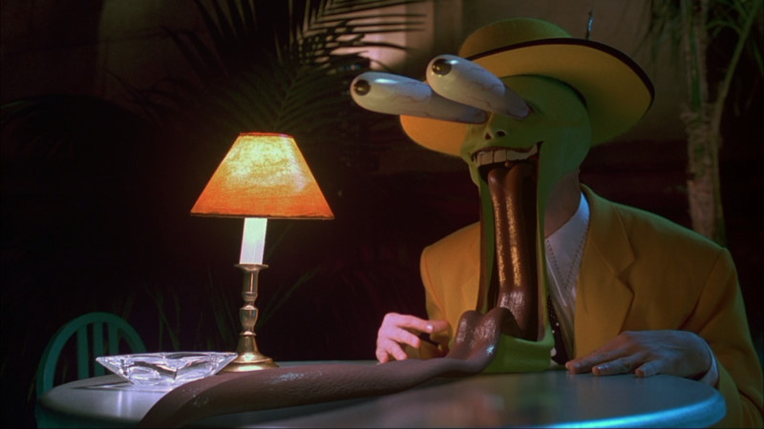
Masking
“Man is least himself when he talks in his own person. Give him a mask, and he will tell you the truth”. Oscar Wilde
Why?

Slide 47
In chapter four, Jack’s mask allows his inner beast to come out and play.
It allows him to become what he really is, a savage. Golding shows that all people are savage but society keeps is civil.
The mask gives anonymity which is crucial to immoral behaviour. Behind a mask you can judge without being judged. You can be cruel without repercussions. You can unleash the inner child inside you.

Slide 48
What happens to Jack after he puts on the mask? His inner beast comes out.
“He looked in astonishment, no longer himself but an awesome stranger”.
“He began to dance and his laughter became a bloodthirsty snarling”.
“The mask was a thing on its own, behind which Jack hid, liberated from shame and consciousness”.

Slide 49
Now, he is able to slaughter the pig when he couldn’t go through with it before (still restrained), he let’s the fire go out and loses a chance for rescue because of his obsession with killing, start eerie chant: “Kill the pig. Cut her throat. Spill her blood”, and now acts violent toward Piggy (hitting him in the stomach and breaking one of the lenses of his glasses, and refuses to let Piggy eat the meat).

Slide 50
Mask Symbolism
At first, Jack’s mask is white and red. He looks at his reflection and is not satisfied, so he makes a new mask. This one has the colors red, white, and black. Red could symbolize blood, white could symbolize purity and humanity, and black could symbolize death and destruction. The white and red are mentioned first. Jack’s humanity is still in the forefront and his personality. Then, the white (his humanity) is being squeezed between the red and black. The white is being overpowered by bloodthirstiness and death. Where have you seen the colors on Jack’s mask before?

Slide 51
Golding did not put those colors on Jack’s mask by accident...

Slide 52
Mask Design
Choose a character from the novel and design a mask for them. The design should fit the character’s personality in some way and the colors must be symbolic. Be creative! In your journal (entry number two) discuss your design and color choices for your mask and comment on how the colors of Jack’s mask are fitting for his personality.

Slide 53
Samples

Slide 56
Chapter Five-Beast From Water
Show pictures of famous monsters. Discussion. What monsters do you know of? What makes them scary? What kinds of monsters are there in different cultures?
Journal. Monsters.
Notes: Monsters as metaphors for society’s fears.
Homework. Students can research through books, internet.
Find a monster they’ve never heard of before. Write down the description and characteristics of this monster. 1 paragraph.

Slide 57
Chapter Five
An assembly is called and the group of kids come. Ralph talks about how they start projects and never finish them. No one is abiding by the rules very strictly; they don't gather water in coconuts anymore, nor do they use the designated places as bathrooms. And of course, there is the matter about the fire. He tells them that "...we ought to die before we let fire out." He tells the hunters that the fire is more important than a pig. Furthermore, he explains that, "Things are breaking up. I don't understand why. We began well; we were happy. And then--...Then people started getting frightened."
They are all frightened of the Beast, and the children have been talking about it -- a large animal living on the island. The Beast, in reality, is something that resides in all of the kids -- a sort of dangerous evil that must be withheld. Ralph, from the start, has tried to hold it back by laying down rules and organizing society. Nonetheless, none of the kids yet realize this, and the Beast is manifested in their minds as an animal lurking on the island.

Slide 58
Jack argues that he has been everywhere on the island and has never seen a beast. Piggy gets up and makes a very important speech in which he states that there isn't a beast, at least, "not with claws, and all that..." Also, "there isn't no fear either...Unless we get frightened of people."
A littlun comes forward and talks of how he had been dreaming about fighting the creepers and saw something "horrid in the forest." It turns out that the horrid thing was Simon, who had been returning from the clearing he likes to be at. Another littlun comes forward, Percival, and explains another type of beast -- the Beast from the water. Again, this is debated. Then, Simon takes the conch and says something very important. He says that, "Maybe there is a beast... What I mean is... maybe it's only us." Simon begins to understand what the Beast really is, but his is jeered at and will be jeered at for the rest of the novel, until his death.

Slide 59
The debate continues and turns toward talk of the rules. Jack doesn't know why Ralph has the right to make rules. He points out that Ralph cannot hunt, nor can he sing. Ralph counters that he was chosen and that is reason enough. More arguing ensues, and, "The world, that understandable and lawful world, was slipping away." Jack turns against Piggy as well: "Bullocks to the rules! We're strong -- we hunt! If there's a beast, we'll hunt it down! We'll beat and beat and beat!" Jack does not like rules and the Beast within him is beginning to expose itself little by little.
The assembly breaks up and the hunters do their dance once again. The boys are drifting apart into two distinct groups: those who follow Ralph’s ideas and those who follow Jack. At the close of the chapter, Ralph, Simon and Piggy are sitting on the assembly platform listening the cries of the littluns' nightmares.

Slide 60
Notes
The boys’ fear of the beast becomes an increasingly important aspect of their lives, especially at night, from the moment the first littlun claims to have seen a snake-monster in Chapter 2. In this chapter, the fear of the beast finally explodes, ruining Ralph’s attempt to restore order to the island and precipitating the final split between Ralph and Jack. At this point, it remains uncertain whether or not the beast actually exists. In any case, the beast serves as one of the most important symbols in the novel, representing both the terror and the allure of the primordial desires for violence, power, and savagery that lurk within every human soul. In keeping with the overall allegorical nature of Lord of the Flies, the beast can be interpreted in a number of different lights. In a religious reading, for instance, the beast recalls the devil; in a Freudian reading, it can represent the id, the instinctual urges and desires of the human unconscious mind. However we interpret the beast, the littlun’s idea of the monster rising from the sea terrifies the boys because it represents the beast’s emergence from their own unconscious minds. As Simon realizes later in the novel, the beast is not necessarily something that exists outside in the jungle. Rather, it already exists inside each boy’s mind and soul, the capacity for savagery and evil that slowly overwhelms them.

Slide 61
As the idea of the beast increasingly fills the boys with dread, Jack and the hunters manipulate the boys’ fear of the beast to their own advantage. Jack continues to hint that the beast exists when he knows that it probably does not—a manipulation that leaves the rest of the group fearful and more willing to cede power to Jack and his hunters, more willing to overlook barbarism on Jack’s part for the sake of maintaining the “safety” of the group. In this way, the beast indirectly becomes one of Jack’s primary sources of power. At the same time, Jack effectively enables the boys themselves to act as the beast—to express the instinct for savagery that civilization has previously held in check. Because that instinct is natural and present within each human being, Golding asserts that we are all capable of becoming the beast.

Slide 62
Chapter Six-Beast From Air
Homework check. In a class discussion students share what they’ve learned. In groups of four, they choose a monster and analyze it. What kind of fears does it represent, keeping in mind the culture and time of its origin. Share ideas with class.
Journal.
i) Now that you’ve read half of the novel, make predictions about what will happen.
ii) If you’ve already finished, think about what will happen after the end of the novel. (For either topic, justify your argument based
on text information).

Slide 63
Chapter Six
Two fighter planes are engaged in a nighttime battle over the island -- more evidence that the world is at war. One of them is shot down and the pilot bails out and opens his parachute, but he is already dead. As the victor flies away the dead man floats to the island only to be caught on the rocks of the mountain. There he will stay for some days, slowly rotting. Presently, though, the twins Samneric are on fire duty and have fallen asleep. They wake up, re-light the fire, and see the "Beast from air" breathing in and out. They run to tell Ralph. As the sun is rising an assembly is called.
The kids all believe that they are now in terrible danger. Jack calls for volunteers to help him go to the top and kill it. A debate ensues and it is determined that the Beast does not leave tracks and moves by swinging through the tree tops, which is why Jack has never seen traces of it. It is decided that a party of hunters, plus Ralph and Simon, will go to hunt the Beast. Piggy is left at the beach with the littluns. They will first check the only place on the island that no one has been to: Castle Rock. If the Beast is not there then they will check the mountain and re-light the fire.
They trek to the castle and discover that nothing is there. Jack exclaims that the rock would make a great fort and he and his hunters proceed to push a boulder into the sea. Ralph breaks up the fun and they start the journey to the mountain.

Slide 64
Notes
As fear about the beast grips the boys, the balance between civilization and savagery on the island shifts, and Ralph’s control over the group diminishes. At the beginning of the novel, Ralph’s hold on the other boys is quite secure: they all understand the need for order and purposive action, even if they do not always want to be bothered with rules. By this point, however, as the conventions of civilization begin to erode among the boys, Ralph’s hold on them slips, while Jack becomes a more powerful and menacing figure in the camp. In Chapter 5, Ralph’s attempt to reason with the boys is ineffective; by Chapter 6, Jack is able to manipulate Ralph by asking him, in front of the other boys, whether he is frightened. This question forces Ralph to act irrationally simply for the sake of preserving his status among the other boys. This breakdown in the group’s desire for morality, order, and civilization is increasingly enabled—or excused—by the presence of the monster, the beast that has frightened the littluns since the beginning of the novel and that is quickly assuming an almost religious significance in the camp.

Slide 65
The air battle and dead parachutist remind us of the larger setting of Lord of the Flies: though the boys lead an isolated life on the island, we know that a bloody war is being waged elsewhere in the world—a war that apparently is a terrible holocaust. All Golding tells us is that atom bombs have threatened England in a war against “the reds” and that the boys were evacuated just before the impending destruction of their civilization. The war is also responsible for the boys’ crash landing on the island in the first place, because an enemy aircraft gunned down their transport plane. Although the war remains in the background of Lord of the Flies, it is nevertheless an important extension of the main themes of the novel. Just as the boys struggle with the conflict between civilization and savagery on the island, the outside world is gripped in a similar conflict. War represents the savage outbursts of civilization, when the desire for violence and power overwhelms the desire for order and peace. Even though the outside world has bestowed upon the boys a sense of morality and order, the danger of savagery remains real even within the context of that seemingly civilized society that has nurtured them.

Slide 66
Chapter Seven-Shadows and Tall Trees
1. Show students pictures of the various book covers of the novel
2. Journal writing-do you feel like you’re a close observer and have an
intimate acquaintance with the characters or do you feel removed in time
or space. Why?
3. In groups of four, discuss whether it was necessary that Ralph went to
the mountain top to gain respect. Arrange one person to be a note-taker, and share discussion results as a class
4. Notes on the “mob mentality” aspect of the game with Robert. We will discuss as a class why this escalated into violence, and the influence which a mob has in situations like this.

Slide 67
Chapter Seven
As they make their way to the mountain they stop to eat and rest and Ralph thinks about how dirty and scraggly they all look. He yearns to have his hair cut and take a bath -- revealing again his character and longing to hold back the wild.
They start off and Jack finds traces of a pig. They decide to hunt it. A boar is found and Ralph wounds him with his spear. He is delighted that he made the only strike on the animal. The boar gets away and the hunters begin to dance again, but this time it is a little different. Robert is playing the part of the pig, but the kids are a slightly out of hand and some of the fake blows to the "pig" are landing hard. Even Ralph, who previously shunned the dance and chanting feels that, "...the desire to squeeze and hurt was overmastering." Here is the first time we see Ralph having trouble suppressing the Beast.
They continue to the mountain and Simon is sent through the forest to tell Piggy and the others that the hunting party will not be back before dark. Night falls as they reach the base of the mountain and the boys argue about whether or not they should wait until morning to scale it. Jack goes to the top and comes back down, reporting that he saw something billowing up on top. They all climb to the summit and see the Beast. Instead of fighting it and finding out that it is only a man, they run. As they flee, "...the creature lifted its head, holding toward them a ruin of a face."

Slide 68
Notes
The boar hunt and the game the boys play afterward provide stark reminders of the power of the human instinct toward savagery. Before this point in the novel, Ralph has been largely baffled about why the other boys were more concerned with hunting, dancing, bullying, and feasting than with building huts, maintaining the signal fire, and trying to be rescued. But when he joins the boar hunt in this chapter, Ralph is unable to avoid the instinctive excitement of the hunt and gets caught up in the other boys’ bloodlust. In this scene, Golding implies that every individual, however strong his or her instinct toward civilization and order, has an undeniable, innate drive toward savagery as well. After the hunt, the boys’ reenactment of the chase provides a further reminder of the inextricable connection between the thrill of the hunt and the desire for power. Robert, the boy who stands in for the boar in the reenactment, is nearly killed as the other boys again get caught up in their excitement and lose sight of the limits of the game in their mad desire to kill. Afterward, when Jack suggests killing a littlun in place of a pig, the group laughs. At this point, probably none of them—except possibly Jack and Roger—would go so far as to actually carry out such a plan. Nonetheless, the fact that the boys find the possibility exciting rather than horrifying is rather unsettling.

Slide 69
By this point, the conflict between Ralph and Jack has escalated to a real struggle for power, as Jack’s brand of violence and savagery almost completely replaces Ralph’s disciplined community in the boys’ conception of their lives on the island. Ralph’s exhilaration in the hunt and his participation in the ritual that nearly kills Robert is, in a sense, a major victory for Jack, for the experience shakes Ralph’s confidence in his own instinct toward morality and order. As befits a power struggle in a savage group, the conflict between Ralph and Jack manifests itself not as a competition to prove who would be the better leader but instead as a competition of sheer strength and courage. Just as Ralph boldly climbed the hill alone to prove his bravery in the previous chapter, Jack goes up the mountain alone now. It is also significant that Ralph discovers nothing, while Jack discovers what he thinks is the beast: while Ralph does not believe in the beast, the beast constitutes a major part of Jack’s picture of life on the island.

Slide 70
Jack increases his leverage within the group by goading Ralph into acting rashly and unwisely, against his tendency toward levelheadedness—a manipulation that weakens Ralph’s position in the group. Although Ralph realizes that it is foolish to hunt the beast at night, he knows that, in a society that values strength, he cannot risk appearing to be a coward. As a result, he assents to going up the mountainside at night. Ultimately, Ralph’s decision to explore the mountain at night costs him the opportunity to prove to the others that Sam and Eric did not see the beast: had the boys climbed the mountain in the daylight as Ralph wished, they would have seen the dead parachutist for what it was. Because they go at night, however, they see the parachutist distorted by shadows and believe it to be the beast. In a sense, the degree to which each boy is prone to see the beast mirrors the degree to which he gives in to his instinct toward savagery. This connection emphasizes the idea that the beast is a symbolic manifestation of the boys’ primitive inner instincts.

Slide 71
Chapter Eight-Gift for the Darkness
Discuss quotation “and now that thing squats by the fire as
though it didn’t want us to rescued” (138)
Journal writing-write a diary entry for one of the characters
Notes on religious sacrifices, their meaning and history and on the historical background of Lord of the Flies (Beelzebub),
cross-references, and its context of Judaism and Christianity
In groups of four, discuss key passages regarding the scene between
Simon and the LOTF, and then groups present it to the class.

Slide 72
Beelzebub
Etymology: Beelzebub, prince of devils, from Latin, from Greek Beelzeboub, from
Hebrew Ba'al zebhubh, a Philistine god, literally, lord of flies
Date: before 12th century
1 : DEVIL
2 : a fallen angel in Milton's Paradise Lost ranking next to Satan

Slide 73
Chapter Eight
The tale of the Beast is related to Piggy and the boys must decide what to do. Ralph tells Jack that they are not armed well enough to kill it. Someone comments that, "...now that thing sits by the fire as though it didn.t want us to be rescued." Which, in a sense, is what the "real beast" is doing.
Jack calls an assembly by blowing the conch. He tells the group that the Beast is real; they have seen it. Also, Ralph has called the hunters cowards and Jack accuses Ralph of being a coward himself. Jack asks the assembly if any of them think Ralph should not be chief. No one raises their hand. Jack, in defiance, says, "All right then... I'm not going to play any longer. Not with you...I'm not going to be a part of Ralph's lot." Jack feels that survival is a game to be played and he is fed up with the rules that Ralph deals. He invites others to come join him and runs off into the forest.
Simon steps forward to propose that they climb the mountain. No one wants to. Instead, Piggy decides that the signal fire should be moved to the beach, and the kids start building a fire. The fire is lit, and as the crowd gathers, it is noticeably smaller. Most of the bigguns have left to go "play" with Jack. The only bigguns left are Ralph, Piggy, Samneric and Simon.

Slide 74
Simon wonders off to the mat of creepers, while Jack gathers a group of boys in the forest to teach them how to hunt. They decide that Jack will be chief, they will forget the Beast, and they will try to take more bigguns away from Ralph.
They begin to track a pig and and it leads them to Simon's clearing. A few pigs are laying around and the group decides to attack a sow and her piglets. The piglets escape, but the sow is brutally killed. Jack decides to offer the pig's head as a gift to the Beast. He orders his new henchman, Roger, to sharpen a stick at both ends. One end is jammed in the rocky earth and the other is draped with the head of the sow. Simon climbs from under the creepers and is confronted with the head.
Later, Jack and his gang raid Ralph's encampment. They steal a burning log for their own fire and Jack invites all the boys to come join his tribe at the feast they are to have that night. As the "savages" leave Ralph comments about how he wishes he could have fun too, but still the fire is more important to him. Nonetheless, this importance of the fire and of rescue are drifting away from Ralph and he must be constantly reminded of it by Piggy. A storm is building above the island and thunder promises rain.

Slide 75
Back at the clearing Simon is having a "discussion" with the pig's head. This discussion is probably mostly in Simon's head, but Golding uses this interview as an eerie way to unveil the theme of the novel. Golding now refers to the fly-covered pig's head as the "Lord of the Flies." The Lord of the Flies asks Simon if he's afraid of him. It says:
"...I am the Beast... Fancy thinking the Beast was something you could hunt and kill! You knew, didn't you? I'm part of you? Close, close, close! I'm the reason it's no go? Why things are the way they are?"Although Simon may have known that the Beast was really inside the kids, it is now confirmed. Now that Simon knows for sure, the Beast warns him not to tell anyone the truth, otherwise he will be killed.

Slide 76
Notes
The excitement the boys felt when Jack suggests killing a littlun in Chapter 7 comes to grotesque fruition in Chapter 8, during the vicious and bloody hunt following Jack’s rise to power and formation of his new tribe. Jack’s ascent arises directly from the supposed confirmation of the existence of the beast. Once the boys, having mistaken the dead parachutist for a monster, come to believe fully in the existence of the beast, all the remaining power of civilization and culture on the island diminishes rapidly. In a world where the beast is real, rules and morals become weak and utterly dispensable. The original democracy Ralph leads devolves into a cult-like totalitarianism, with Jack as a tyrant and the beast as both an enemy and a revered god. We see the depth of the boys’ growing devotion to the idea of the beast in their impalement of the sow’s head on the stake as an offering to the beast. No longer simply a childish nightmare, the beast assumes a primal, religious importance in the boys’ lives. Jack uses the beast ingeniously to rule his savage kingdom, and each important character in Lord of the Flies struggle to come to terms with the beast. Piggy, who remains steadfastly scientific and rational at this point in the novel, is simply baffled and disgusted. Ralph, who has seen what he thinks is the beast, is listless and depressed, unsure of how to reconcile his civilized ideals with the sight he saw on the mountaintop. But the most complex reaction of all comes from one of the novel’s most complex characters—Simon.

Slide 77
Simon’s confrontation with the Lord of the Flies—the sow’s head impaled on a stake in the forest glade—is arguably the most important scene in the novel, and one that has attracted the most attention from critics. Some critics have interpreted the scene as a retelling of Jesus’ confrontation with Satan during his forty days in the wilderness, a story originally told in the Gospels of the New Testament. Indeed, many critics have described Simon as a Christ figure, for he has a mystical connection to the environment, possesses a saintly and selfless disposition, and meets a tragic and sacrificial death. Others tie the scene into a larger Freudian reading of Lord of the Flies, claiming that its symbols correspond exactly to the elements of the Freudian unconscious (with Jack as the id, Ralph as the ego, and Piggy as the superego). Lord of the Fliesmay indeed support these and a number of other readings, not necessarily at the exclusion of one another.

Slide 78
Indeed, many differences between Simon and Jesus complicate the comparison between the two and prevent us from seeing Simon as a straightforward Christ figure. Simon, unlike Jesus, is not a supernatural being, and none of the boys could possibly find salvation from the Lord of the Flies through faith in Simon. Rather, Simon’s terror and fainting spell indicate the horrific, persuasive power of the instinct for chaos and savagery that the Lord of the Flies represents. Simon has a deep human insight in the glade, for he realizes that it is not a real, physical beast that inspires the hunters’ behavior but rather the barbaric instinct that lies deep within each of them. Fearing that this instinct lies embedded within himself as well, Simon seems to hear the Lord of the Flies speaking with him, threatening him with what he fears the most. Unable to stand the sight any longer, Simon collapses into a very human faint.

Slide 79
In all, Simon is a complex figure who does not fit neatly into the matrix framed by Jack at the one end and Ralph at the other. Simon is kindhearted and firmly on the side of order and civilization, but he is also intrigued by the idea of the beast and feels a deep connection with nature and the wilderness on the island. Whereas Jack and Roger connect with the wilderness on a level that plunges them into primal lust and violence, Simon finds it a source of mystical comfort and joy. Simon’s closeness with nature and his unwaveringly kind nature throughout the novel make him the only character who does not feel morality as an artificial imposition of society. Instead, we sense that Simon’s morality and goodness are a way of life that proceeds directly and easily from nature. Lord of the Flies is deeply preoccupied with the problem of fundamental, natural human evil—amid which Simon is the sole figure of fundamental, natural good. In a wholly nonreligious way, Simon complicates the philosophical statement the novel makes about human beings, for he represents a completely separate alternative to the spectrum between civilization and savagery of which Ralph and Jack are a part. In the end, Simon is both natural and good in a world where such a combination seems impossible.

Slide 80
Chapter Nine-A View to a Death
Notes on conflict in the story
In pairs, one students will be Jack and the other Ralph-each write
letters to each other (alternately, on the same sheet) about their conflict.
Notes on setting. As a class, discuss aspects of setting in the novel
On blank paper, students draw a scene/image which the setting evokes.
Journal- write an entry about violence you witnessed or have been
close to.

Slide 81
Poems about Simon’s death
"Simon's Fate "
As the sun separates from the clouds,
Jack floats away from Ralph.
As Jack's new tribe forms,
Ralph rages as does the storm.
Lightning flashes in everybody eyes,
And they kill Simon, much to Ralph's surprise.
As Simon lays on the beach,
Ralph's conscience seems to be reached;
And as the boys say "Goodbye,"
Simon floats out with the tide.

Slide 82
"Peace“
As he lays upon the beach,
He sees what is in reach.
He sees the light,
And he does not fight.
The land of murders is at his feet,
And as he floats out into the sea,
He now knows what his fate will be.
God has taken him and given him a home.
He is now resting in God's great dome.
He is in the dome of love, the dome of peace.
Peace is his for everlasting tranquility.

Slide 83
Chapter Nine
The storm keeps boiling over the island, possibly representing the turmoil that is occurring below it. Simon regains consciousness and heads for the mountain. He sees the rotting airman and realizes the Beast is "harmless and horrible," which, in reality is true. If the boys choose to suppress the Beast it is harmless, or they can let it run rampant. Simon makes his way to the beach to tell the other boys.
Piggy and Ralph have decided to go to the pig roast, just to see what is going to happen. All of the other boys are already there, except Simon, and they fall silent as the two outcasts approached. They are both given portions of meat as Jack begins a speech. He asks who will join his tribe. Ralph interrupts -- trying to persuade the boys to help him keep the fire going. The crowd of boys instead agree to join Jack, who promises to give them meat and keep them safe from the Beast.

Slide 84
The storm breaks and the rain comes down with lightning and thunder. Ralph is asking them what they're going to do without shelters and Jack orders them to begin the dance. As they chant around Roger, who is playing the pig, Piggy and Ralph "...found themselves eager to take place in this demented but partly secure society." The boys in the dance are armed with clubs and spits and are getting out of hand again with this game.
A figure is crawling out of the forest and the ring opens to let it inside. Mistaken as the Beast by the Jack's tribe, Simon is beaten to death. The group disbands for shelter from the storm. On top of the mountain wind fills the parachute of the airman and lifts him away from the island. As the storm subsides and the tide moves in and out, Simon's body is washed to sea.

Slide 85
Notes
With the brutal, animalistic murder of Simon, the last vestige of civilized order on the island is stripped away, and brutality and chaos take over. By this point, the boys in Jack’s camp are all but inhuman savages, and Ralph’s few remaining allies suffer dwindling spirits and consider joining Jack. Even Ralph and Piggy themselves get swept up in the ritual dance around Jack’s banquet fire. The storm that batters the island after Simon’s death pounds home the catastrophe of the murder and physically embodies the chaos and anarchy that have overtaken the island. Significantly, the storm also washes away the bodies of Simon and the parachutist, eradicating proof that the beast does not exist.

Slide 86
Jack makes the beast into a godlike figure, a kind of totem he uses to rule and manipulate the members of his tribe. He attributes to the beast both immortality and the power to change form, making it an enemy to be feared and an idol to be worshiped. The importance of the figure of the beast in the novel cannot be overstated, for it gives Jack’s tribe a common enemy (the beast), a common system of belief (their conviction that the mythical beast exists), a reason to obey Jack (protection from the beast), and even a developing system of primitive symbolism and iconography (face paint and the Lord of the Flies).

Slide 87
In a sense, Simon’s murder is an almost inevitable outcome of his encounter with the Lord of the Flies in Chapter 8. During the confrontation in the previous chapter, the Lord of the Flies foreshadows Simon’s death by promising to have some “fun” with him. Although Simon’s vision teaches him that the beast exists inside all human beings, his confrontation with the beast is not complete until he comes face-to-face with the beast that exists within the other boys. Indeed, when the boys kill Simon, they are acting on the savage instinct that the beast represents.

Slide 88
Additionally, the manner of Simon’s death continues the parallels between Simon and Jesus: both die sacrificial deaths after learning profound truths about human morality. But Simon’s death differs from Jesus’ in ways that complicate the idea that Simon is simply a Christ figure. Although Jesus and Simon both die sacrificial deaths, Jesus was killed for his beliefs, whereas Simon is killed because of the other boys’ delusions. Jesus died after conveying his message to the world, whereas Simon dies before he is able to speak to the boys. In the biblical tradition, Jesus dies to alleviate the burden of mankind’s sin; Simon’s death, on the other hand, simply intensifies the burden of sin pressing down upon the island. According to the Bible, Jesus’ death shows others the way to salvation; Simon’s death exemplifies the power of evil within the human soul.

Slide 89
Chapter Ten-The Shell and the Glasses
Students write their greatest fear on a card, and may share with the class and explain.
Notes-discuss aspects of fear in the chapter; examine why fear of the beast and fear of others are a driving force.
Notes on propaganda. In groups, I will give two aspects of propaganda in which the students
will determine if Jack uses them or not. Share as a class.
Journal-personal response to the novel

Slide 90
Chapter Ten
It is the next morning and the only boys still in Ralph's confidence are Piggy and Samneric. The twins are in the forest collecting firewood while Ralph and Piggy discuss Simon's murder and what they are going to do next. Piggy tries to make excuses for the boys by claiming it was an accident, but Ralph doesn't buy into that.
On Castle Rock Jack (now continually painted) has created a fortification that is constantly guarded. If, for whatever reason they need to defend themselves, Roger has placed a lever underneath a large boulder that will send it smashing onto the rock bridge that conects the fort to the mainland. Jack has begun to rule by force and the kids who are out of line are tied up and beaten. He decides the tribe will hunt again tomorrow. Although some of them realize they have killed Simon it is sensed that they are trying to it cover up by convincing themselves they really just hurt the disguised beast.

Slide 91
Back at the lagoon Ralph and the rest are agonizing over trying to keep the fire going. Again, Ralph must constantly be reminded by Piggy that the fire is "Something overwhelmingly good." Ralph tells the protesting twins that "Anyone can play at hunting, anyone can get us meat"; anyone can buy into the irresponsible and harmful desires within them, but it is not easy to hold them at bay. They decide to leave the fire unlit for the night, and retire to the rickety shelters.
During the night they awake to noises outside and they are afraid the Beast has come for them, but is only Jack and his tribe searching to steal fire. Not finding a lit fire they charge into the shelter and in the violent fight that ensues, Piggy's specs are stolen. They have now been stripped of the ability to make fire and the only symbol of society and order that is left to them is the conch.

Slide 92
Notes
In the period of relative calm following Simon’s murder, we see that the power dynamic on the island has shifted completely to Jack’s camp. The situation that has been slowly brewing now comes to a full boil: Jack’s power over the island is complete, and Ralph is left an outcast, subject to Jack’s whims. As civilization and order have eroded among the boys, so has Ralph’s power and influence, to the extent that none of the boys protests when Jack declares him an enemy of the tribe. As Jack’s power reaches its high point, the figures of the beast and the Lord of the Flies attain prominence. Similarly, as Ralph’s power reaches its low point, the influence and importance of other symbols in the novel—such as the conch shell and Piggy’s glasses—decline as well. As Ralph and Piggy discuss Simon’s murder the following morning, Ralph clutches the conch shell to him for solace, but the once-potent symbol of order and civilization is now useless. Here, Ralph clings to it as a vestige of civilization, but with its symbolic power fading, the conch shell is merely an object. Like the signal fire, it can no longer give Ralph comfort. Piggy’s glasses, the other major symbol of civilization, have fallen into Jack’s hands. Jack’s new control of the ability to make fire emphasizes his power over the island and the demise of the boys’ hopes of being rescued.

Slide 93
We learn a great deal about the different boys’ characters through their varying reactions to Simon’s death. Piggy, who is used to being right because of his sharp intellect, finds it impossible to accept any guilt for what happened. Instead, he sets his mind to rationalizing his role in the affair. Ralph refuses to accept Piggy’s easy rationalization that Simon’s death was accidental and insists that the death was a murder. Yet the word murder, a term associated with the rational system of law and a civilized moral code, now seems strangely at odds with the collective madness of the killing. The foreignness of the word in the context of the savagery on the island reminds us how far the boys have traveled along the moral spectrum since the time when they were forced to follow the rules of adults.

Slide 94
Jack, for his part, has become an expert in using the boys’ fear of the beast to enhance his own power. He claims that Simon really was the beast, implying that the boys have a better grasp of the truth in their frenzied bloodlust than in their calmer moments of reflection. This conclusion is not surprising coming from Jack, who seems almost addicted to that state of bloodlust and frenzy. Jack’s ability to convince the other boys that the state of bloodlust is a valid way of interacting with the world erodes their sense of morality even further and enables Jack to manipulate them even more.

Slide 95
Chapter Eleven-Castle Rock
Discuss “they only knew too well the liberation into savagery that the concealing paint brought” (191)
Journal writing-which character changed the most and why
Think-pair-share- in pairs, students discuss the characters Simon, Piggy, Ralph, Jack, the twins, Roger, and the littluns share as a class
Students will write a biography on Roger and draw him hand in

Slide 96
Chapter Eleven
At day break the four plundered and bruised boys try to ignite any smoldering ashes left in the fire, but it is dead. In desperation Ralph calls an assembly. Only the four boys plus some littluns attend. Ralph speculates that maybe if they try to comb their hair, and look decent they could go to Jack to ask for the specs, " -- after all we aren't savages really and being rescued isn't a game" Piggy agrees to this idea and talks about Simon's murder and the death of the littlun in the first fire:
"What can he do more than he already has? I'll tell him what's what. You let me carry the conch, Ralph. I'll show him the one thing he hasn't got."As they get ready they eat, Samneric are afraid to go because Jack will be painted. They set off; with Ralph and the twins carrying spears and Piggy the conch, being led because he cannot see with out his specs.
They reach Castle Rock and Ralph steps out onto the neck of land leading to it with Piggy just behind, and the twins after him. Roger, the guard, orders them to halt and Ralph blows the conch. He tells the savages that he is calling an assembly. Jack emerges from the forest behind him with his hunters and the carcass of a pig. Ralph demands the specs to be returned and the tribe laughs at him.

Slide 97
Ralph and Jack fight each other briefly using spears as sabers. Jack gets between Ralph and the rock and orders the twins captured. Some kids come out to tie up Samneric and Ralph has had enough; Jack and Ralph charge each other and begin fighting again. Piggy stands up and yells for them to stop and listen to him. Surprisingly, the crowd is silent and Piggy, holding the conch, asks, "Which is better -- to have rules and agree, or to hunt and kill? Which is better, law and rescue, or hunting and breaking things up?" During this speech, the tribe, bearing spears, has formed along the far side of the rock bridge intending to charge.
A great yell goes up and Roger heaves on the lever. The huge boulder totters and crashes onto the bridge. Ralph ducks out of the way, but the blind Piggy does not move. As the boulder strikes him the conch explodes "...into a thousand white fragments..." Piggy falls forty feet to his death on the rocks below. Jack feels no sympathy and warns Ralph that that's what he'll get. The tribe charges and Ralph is running, crashing through the forest. The pursuit does not last long and Jack orders the crowd back to the fort. Ralph is free, for the time being.

Slide 98
Notes
In the chaos that ensues when Ralph’s and Jack’s camps come into direct conflict, two important symbols in the novel—the conch shell and the Lord of the Flies—are destroyed. Roger, the character least able to understand the civilizing impulse, crushes the conch shell as he looses the boulder and kills Piggy, the character least able to understand the savage impulse. As we see in the next chapter, Ralph, the boy most closely associated with civilization and order, destroys the Lord of the Flies, the governing totem of the dark impulses within each individual. With Piggy’s death and Sam and Eric’s forced conversion to Jack’s tribe, Ralph is left alone on the island, doomed to defeat by the forces of bloodlust and primal chaos.

Slide 99
Appropriately, Ralph’s defeat comes in the form of the hunt, which has been closely associated with the savage instinct throughout Lord of the Flies. Ironically, although hunting is necessary to the survival of the group—there is little other food on the island aside from fruit, which has made many of the boys sick—it is also what drives them into deadly barbarism. From the beginning of the novel, the hunters have been the ones who have pioneered the way into the realm of savagery and violence. Furthermore, the conflict between Ralph and Jack has often manifested itself as the conflict between the interests of the hunters and the interests of the rest of the group. In Chapter 3, for instance, the boys argue over whether Jack’s followers should be allowed to hunt or forced to build huts with Ralph and Simon. Now that Jack and the forces of savagery have risen to unchallenged prominence on the island, the hunt has thoroughly won out over the more peaceful civilizing instinct. Rather than successfully mitigate the power of the hunt with the rules and structures of civilization, Ralph becomes a victim of the savage forces the hunt represents—he has literally become the prey.

Slide 100
Chapter Twelve-The Cry of the Hunters
Plot overview of the novel
Students will get into groups which are divided according to chapters,
and work together to compose a wall chart depicting the events of the
story.
In class debate based on the pros and cons of the novel, whether or not
it was good, its relevance/irrelevance to present society, etc.
Journal- why/why not would this make a good TV series, OR choose a
character and his life in ten years
For homework: in pairs, have students find information about Coral
Island (2 sources), which the novel was based on. Discuss as class the
next day.

Slide 101
Chapter Twelve
Night falls and Ralph stays close to Castle Rock. Samneric, now savages, have been stationed as guards. Ralph crosses the bridge and scales the tower to talk to them. They tell Ralph that Jack and the tribe are going to hunt him tomorrow. The plan is that the kids will make a line stretching from one shore of the island to the other and they will slowly advance until they find him. When Ralph asks what they will do when he is caught, the twins reply, "Roger has sharpened a stick at both ends," but Ralph does not attach meaning to this. He tells Samneric that he plans to hide in the thicket near Castle Rock, thinking that Jack will not look so close to the fort.
Ralph wakes up the next morning and the twins have been forced to confess where Ralph is hiding. The tribe tries to roll another boulder from the castle to land in Ralph's thicket, but they just barely miss him. A savage tries to crawl through the branches to see if Ralph is still there and gets the business end of a spear. They set the thicket on fire and Ralph runs into the forest as the line of savages spreads out to begin the sweep of the island.

Slide 102
Deciding that the best option is to hide, Ralph finds the place where Simon used to stay and hunkers down. As the line of savages advances the entire island behind them is burning, but they only seek to catch and kill Ralph. The line reaches his hiding spot and Roger peeks under to look. Ralph charges him and runs to the beach, the tribe pursuing. He runs past the burning shelters right into a Navy officer.
Ironically, the massive fire and smoke enabled the ship to see them. As the boys gather around, the officer comments on how it must be all be fun and games. Some of the boys are crying, realizing what they've done. The officer sees the spears and asks, "We saw your smoke. What have been doing? Having a war or something?" He learns that two children have been killed and they are taken off the island to the waiting cruiser. As they are taken away, "...Ralph wept for the end of innocence, the darkness of man's heart, and the fall through the air of the true, wise friend called Piggy."

Slide 103
Notes
After Ralph’s tense, exciting stand against the hunters, the ending of Lord of the Flies is rife with irony. Ralph had thought the signal fire—a symbol of civilization—was the only way to lure rescuers to the island. Ironically, although it is indeed a fire that lures a ship to the island, it is not an ordered, controlled signal fire but rather the haphazard forest fire Jack’s hunters set solely for the purpose of killing Ralph. As we have seen, Ralph has worked tirelessly to retain the structure of civilization and maximize the boys’ chances of being rescued. Now, when all he can do is struggle to stay alive as long as possible, a deus ex machina (an improbable or unexpected device or character that suddenly appears to resolve a situation) appears, at the last possible moment, in the form of the naval officer who brings the boys back to the world of law, order, and society. Golding’s use of irony in the last chapter blurs the boundary between civilization and savagery and implies that the two are more closely connected than the story has illustrated. Ultimately, the boys’ appalling savagery brings about the rescue that their coordinated and purposeful efforts were unable to achieve.

Slide 104
Much of the irony at the end of the novel stems from Golding’s portrayal of the naval officer. Although the naval officer saves Ralph, the ending of Lord of the Flies still is not particularly happy, and the moment in which the officer encounters the boys is not one of untainted joy. The officer says that he is unable to understand how upstanding British lads could have acted with such poor form. Ironically, though, this “civilized” officer is himself part of an adult world in which violence and war go hand in hand with civilization and social order. He reacts to the savage children with disgust, yet this disgust is tinged with hypocrisy. Similarly, the children are so shocked by the officer’s presence, and are now psychologically so far removed from his world, that they do not instantly celebrate his arrival. Rather, they stand before him baffled and bewildered. Even Ralph, whose life has literally been saved by the presence of the ship, weeps tears of grief rather than joy. For Ralph, as for the other boys, nothing can ever be as it was before coming to the island of the Lord of the Flies.

Slide 105
Video Summary
http://www.youtube.com/watch?v=-tXpA3dIEtI

