Slide 1
Elements of a Short Story
English 1201
Ms. Earle

Slide 2
Story Terms
Plot
Setting
Characters
Point of View
Theme

Slide 3
Plot
Plot is what happens and how it happens in a narrative. A narrative is any work that tells a story, such as a short story, a novel, a drama, or a narrative poem.

Slide 4
Parts of the Plot
Exposition: the background information in a story. The opening situation-event that gives rise to conflict. Includes the setting (time, place, situation).
Rising action: event that complicates or intensifies the main conflict. Action and suspense increases.
Climax: the highest point of interest or suspense in the story. The conflict gets resolved.
Falling action: the logical result of the climax. The action and suspense decreases.
Resolution or Denouement: the final resolution of the story. All loose ends must be tied up.

Slide 5
Conflict
Conflict is a struggle between opposing forces.
Every plot must have some form of conflict.
Stories can have more than one conflict.
Conflicts can be:
External: a struggle with an outside force-another person, group, animal, nature, or a nonhuman obstacle.
Internal: a struggle that takes place inside the characters mind.

Slide 6
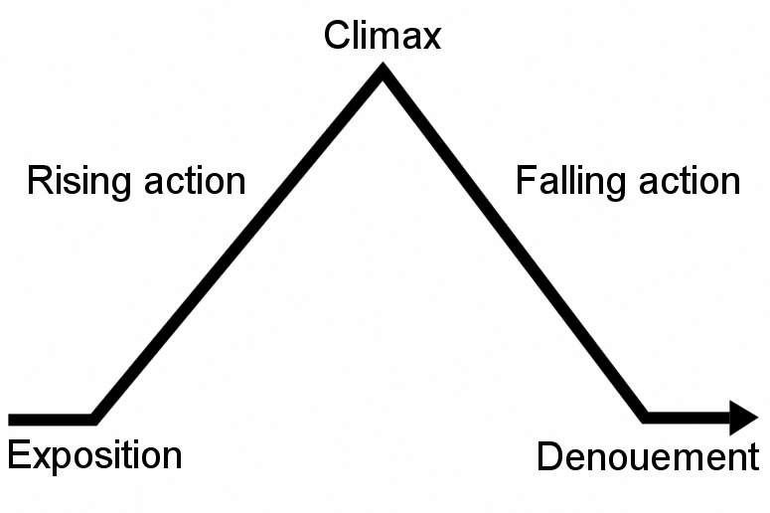
Diagram of the plot

Slide 7
Special Techniques of the plot
Suspense: when the reader wonders what will happen next. It is excitement of tension.
Foreshadowing: hints or clues about what will happen next in the story.
Flashback: interrupts the normal sequence of events to tell about something that happened in the past.
Surprise ending: a conclusion that the reader did not expect (use of irony).

Slide 8
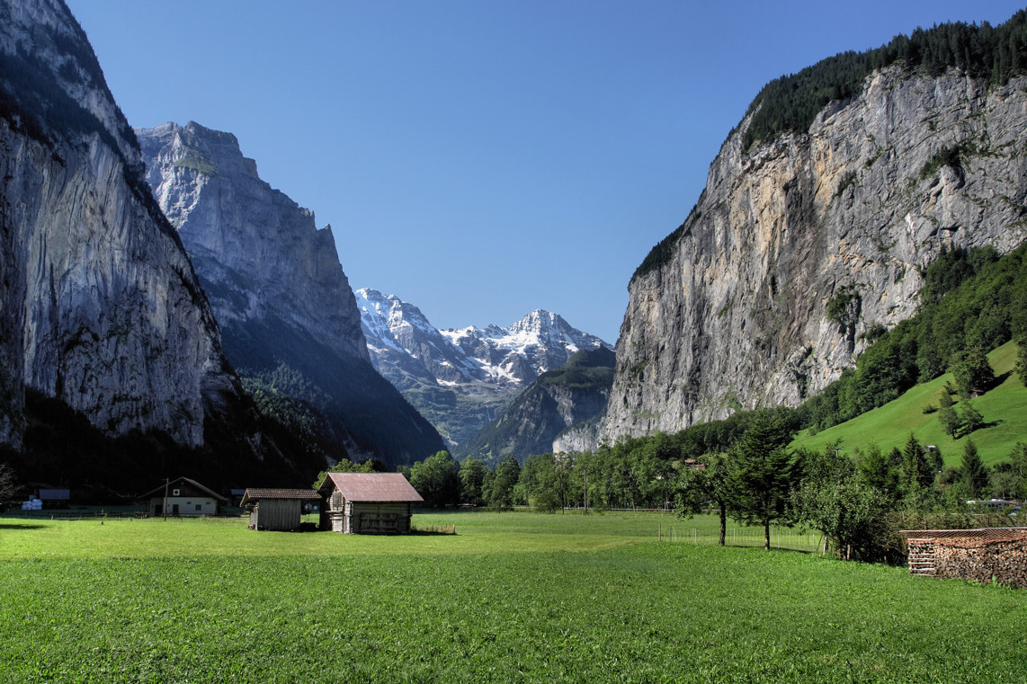
Setting
The time, place and circumstances of a story.
Details that describe:
Furniture
Scenery
Customs
Transportation
Clothing
Dialect
Weather
Time of day
Time of year

Slide 9
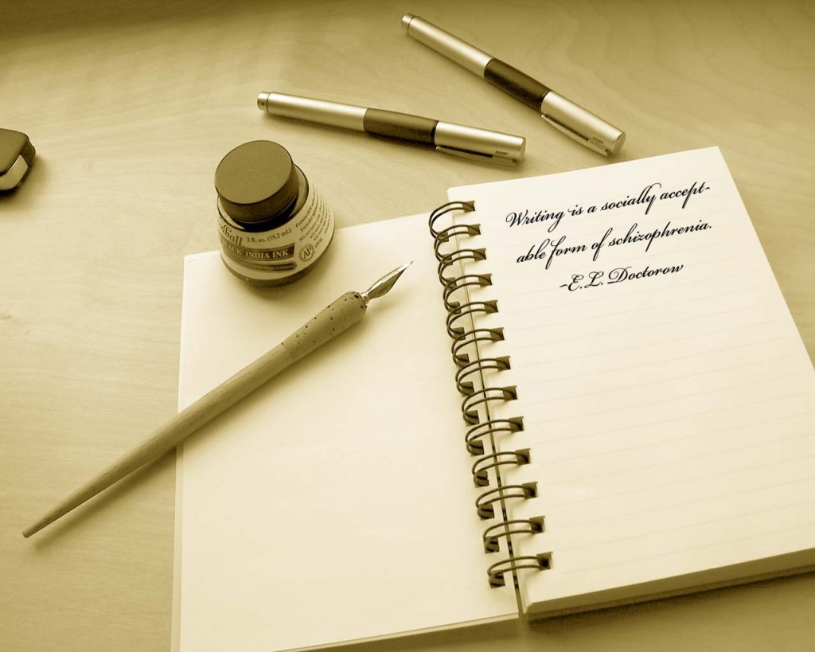
Atmosphere
Is the overall feeling or emotion of a piece of writing.
Atmosphere is created by:
The mood
Feelings
Word choice
Weather

Slide 10
The Functions of a setting
To create a mood or Example:
atmosphere. “We left the home place behind,
To show a reader a mile by slow mile, heading for the
different way of life. mountains, across the prairies where
To make action seem the wind blew forever. At first there
more real. Were four of us with one horse wagon
To be the source of and a skimpy load. Pa and I walked,
conflict or struggle. because I was a big boy of eleven. My
To symbolize an idea. two little sisters romped and trotted until they got tired and had to be boosted up into the wagon bed. It was just an old farm wagon, drawn by one weary horse, creaking and rumbling westward to the mountains, toward the little woods town where Pa thought he had an uncle who owned a little two-bit saw mill.”
“The day the sun came out” D. Johnson

Slide 11
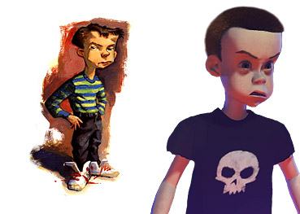
Types of characters
People or Animals
Major characters
Minor characters
Round characters
Flat characters

Slide 12
Types of Characters
Main character: is usually round, fully developed and is the protagonist (the hero or most important character in a story).
Minor character: is usually flat and is often the relative or friend of the main character.
Antagonist: is the character the works against the protagonist. It is often a villain or enemy in the story.

Slide 13
Characterization
Through characterization a writer reveals what a character is like and how the character changes throughout the story.
Two primary methods of characterization:
Direct characterization: the writer tells us directly what a character is like.
Indirect characterization: the writer shows us what a character is like by describing what the character looks like, by telling what the character says and does, and by what other characters say about and do in response to the character.

Slide 14
Direct characterization
“...and I don’t believe in standing around with somebody in my face doing a lot of talking. I much rather just knock you down and take my chances even if I’m a little girl with skinny arms and a squeaky voice, which is how I got the name Squeaky.”
From “Raymond’s Run” T. Bambara

Slide 15
Indirect Characterization
“The old man bowed to all of us in the room. Then he removed his hat and gloves, slowly and carefully. Chaplin once did that in a picture, in a bank-he was the janitor”.
From “Gentlemen of Rio en Medio” by J. Sedillo

Slide 16
Two primary types of character
Round: reveals varied and sometimes contradictory traits, which makes the character more realistic.
Flat: reveals only one or two traits.

Slide 17
Factors in analysing characters
Physical appearance of the character
Personality
Background/personal history
Motivation
Relationships
Conflict
Does the character change and how?

Slide 18
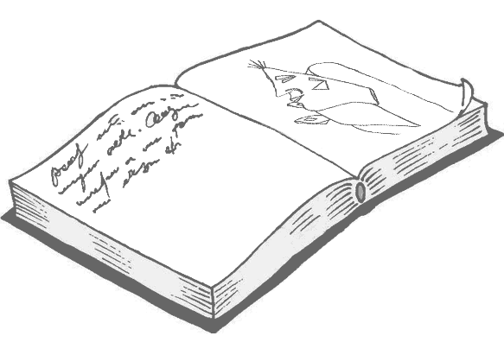
Theme
A central message, concern or insight into life expressed through a literary work.
It can be expressed in a one or two sentence statement about human beings or about life.
They may be stated directly or implied.
Interpretation uncovers the theme.

Slide 19
Example of theme
“Every man needs to feel allegiance to his native country, whether he always appreciates that country or not”.
From “A man without a country” by Edward Hale

