Slide 1
World Religions 3106 Unit I: Judaism

Slide 2
Handouts
Fast Facts on Judaism
Jewish Hatred
Jewish Symbols
Judaism Notes
Who Are the Jews?

Slide 3
Founder: Abraham
All Jews trace their genetic and religious ancestry to Abraham, who lived around 1900 B.C.
He lived in Ur, in present day Iraq
Abraham made a covenant with God, who promised to make of him “a great nation” if he followed God’s commandments
He journeyed to Canaan, present day Palestine, the “promised land”
Abraham was the first person in recorded history to worship Yahweh, the all-powerful God worshipped by Jews, Christians and Muslims – 3 billion people

Slide 4
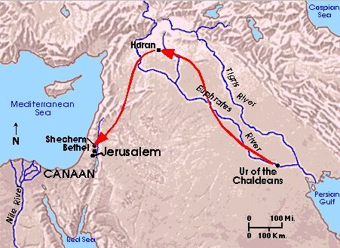
The Journey of Abraham

Slide 5
Central Beliefs
Jews believe that they are the “Chosen People,” since God chose their ancestor Abraham to form his “Covenant” with
Jews believe that present day Israel is the “Promised Land,” since God promised this land to Abraham and his descendants

Slide 6
Abraham’s Son Isaac
Abraham was the first of the “Patriarchs”
All Jews trace their ancestry through Abraham’s son Isaac
All Arabs trace their ancestry through Abraham’s eldest son Ishmael
The bible says God commanded Abraham to sacrifice his son Isaac, but stopped him just as he was about to slaughter him

Slide 7
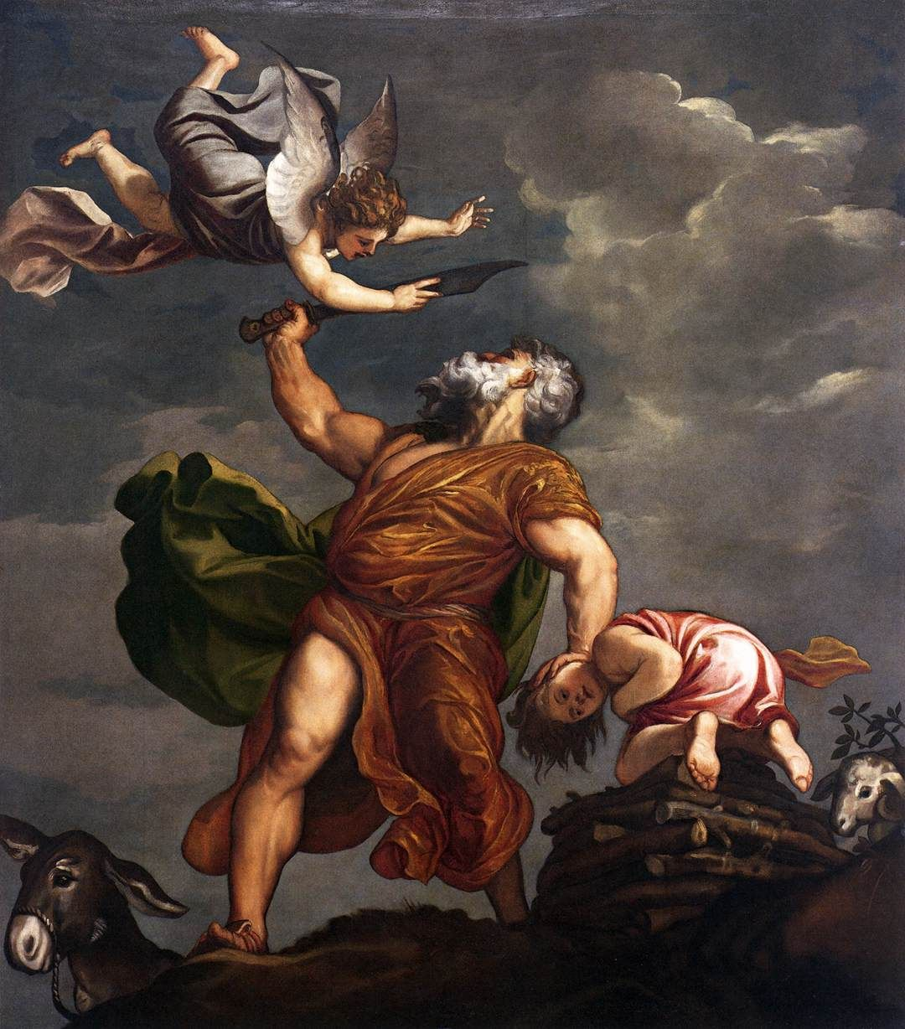
The Sacrifice of Isaac Titian 1542

Slide 8
Isaac’s Son Jacob
Isaac had two sons, Jacob and Esau, the eldest
Jacob was renamed Israel after wrestling with an angel

Slide 9
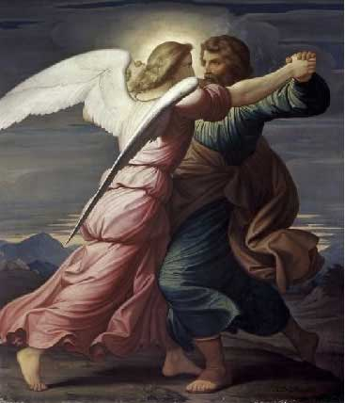
Israel,“One who wrestles with God.”

Slide 10
The Twelve Tribes of Israel
Jacob had 12 sons, who gave rise to the 12 tribes of Israel
There was a drought in Canaan, and the descendents of Abraham moved to Egypt
The Hebrew people lived in Egypt for hundreds of years, until the Exodus ~ 1200 B.C.
They were treated as second class citizens, and they wished to leave
Handout – “Twelve Tribes of Israel”

Slide 11
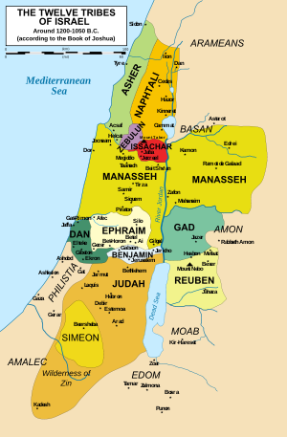
The Twelve Tribes of Israel

Slide 12
Passover
God visits 10 plagues on the Egyptians
The 10th is the death of every firstborn (son)
Hebrews put lamb’s blood on their lintels (doorposts)
The angel of death “passes over” their homes
Jews celebrate Passover every spring around Good Friday. (2013: Sundown Monday, March 25th – sundown Tuesday, April 2nd)
Note: Jesus was arrested and crucified during Passover celebrations in Jerusalem

Slide 13
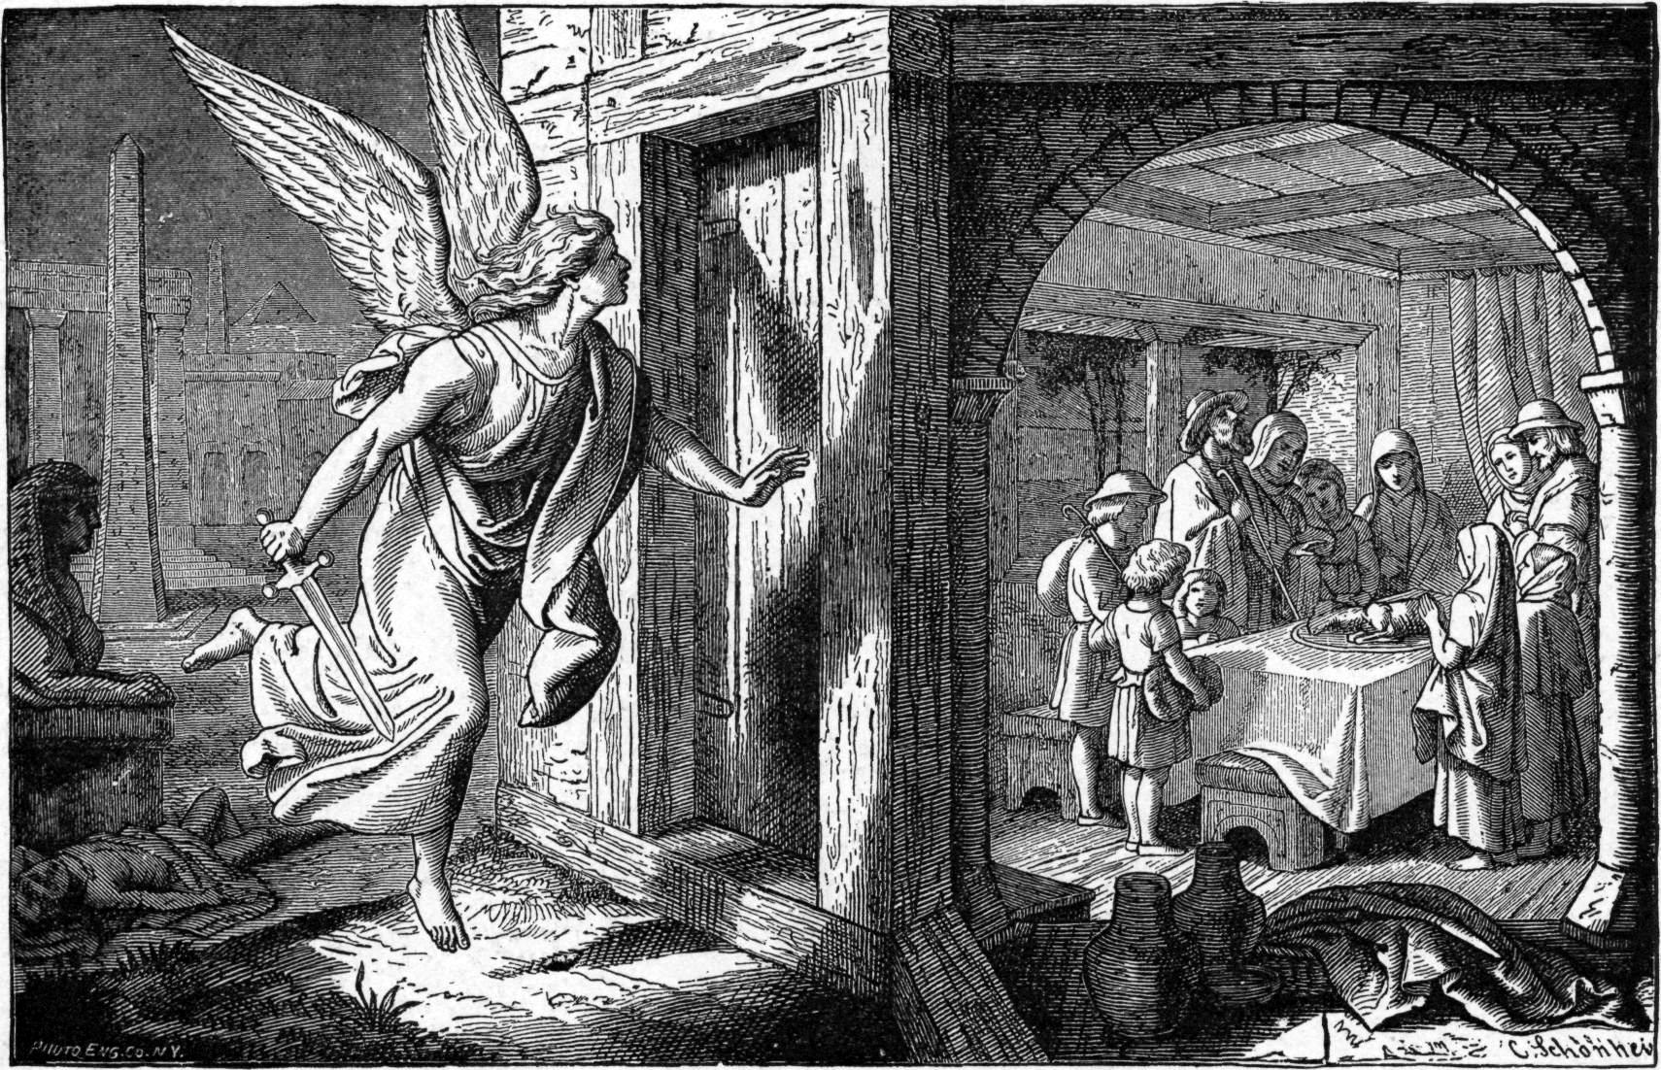
Passover

Slide 14
The Exodus
Moses led the Hebrews out of Egypt ~1200BC
They crossed the Red Sea and wandered in the desert for 40 years
Eventually, they conquered the cities of Canaan and established Israel ~ 1000 BC

Slide 16
The Ten Commandments
Moses received the Ten Commandments from Yahweh on a mountaintop
Side note: He actually received the commandments twice. The first time Moses came down the Israelites were worshipping a golden calf, so he smashed them. Later, he went back.

Slide 17
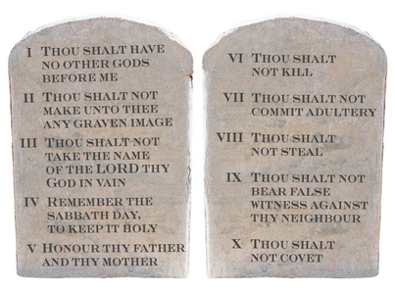
The Ten Commandments

Slide 18
Film
The Prince of Egypt
Complete questions on this movie

Slide 19
The Kingdom of David
The Israelites eventually conquered all of Canaan. David reigned c.1000 B.C.
He defeated the Philistines through single combat with their champion Goliath. (Similar to Trojan war)

Slide 20
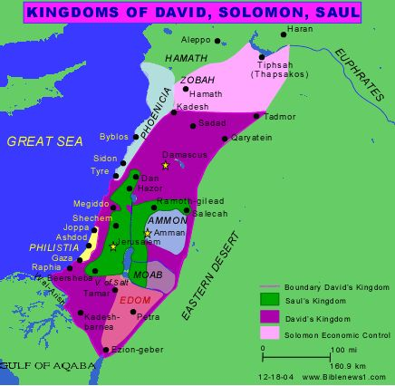
Saul, David and Solomon United Israel 1050-950 B.C.

Slide 21
The Kingdom Divided
After Solomon, the nation divided. The 10 northern tribes become Israel. The 2 southern tribes become Judah
It remains like this for 200 years, until Israel is destroyed by Assyria in the 700s B.C.

Slide 22
Israel and Judah
Note: The ten northern tribes are the “lost tribes” of Israel, scattered when the Assyrians conquered them (721 B.C.).
Judah survives.

Slide 23
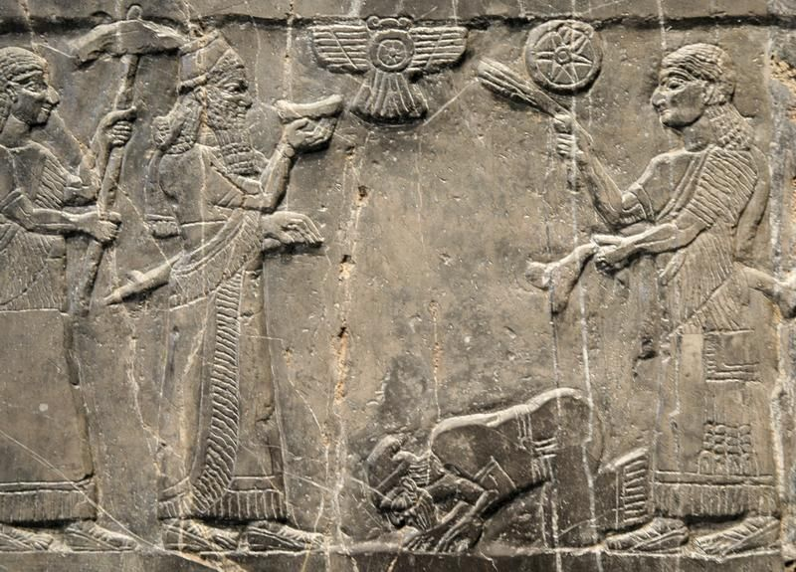
The Assyrians
Assyrian relief showing Israelite King Jehu bowing to the Assyrian King.

Slide 24
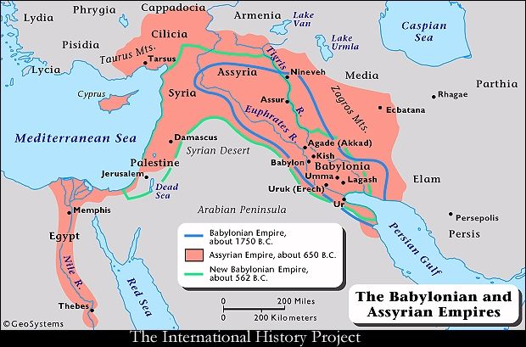
The Assyrians
The Assyrian Empire 650 B.C.

Slide 25
The Babylonian Exile
In 586 B.C. Judah is conquered by the Babylonians. Many are taken to Babylon as captives and slaves. They remain there for 50 years
In Jerusalem, the 1st temple (Solomon’s temple), the heart of Judaism, is destroyed. Synagogues are born during this time
During the exile, the Torah (The 5 “Books of Moses” --Genesis, Exodus, Leviticus and Numbers), is written down in its present form
Jews wait for a “Messiah” to deliver them from captivity

Slide 26
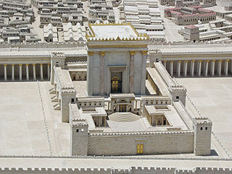
The Second Temple
The Persians allow Jews to return to Jerusalem and rebuild the temple. The Ark of the Covenant is kept in the Holy of Holies

Slide 27
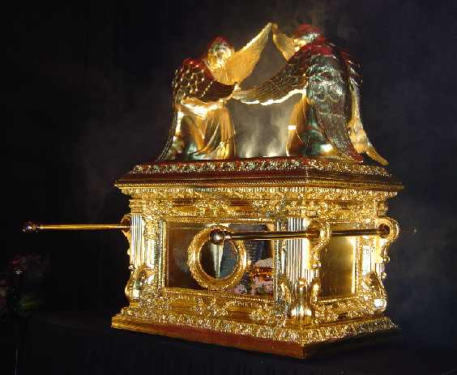
The Ark of the Covenant
Inside:
The stone tablets given to Moses, manna from the exodus, and Aaron’s rod

Slide 28
Greek Conquest
In 332 B.C. Alexander the Great conquer Judah, bringing “Hellenization” (Greek learning and customs)
Jews settle throughout the Mediterranean beginning the “Diaspora”
The Maccabees overthrow the Greek rulers in 164 B.C. The story of “Hanukkah” celebrates this event

Slide 29
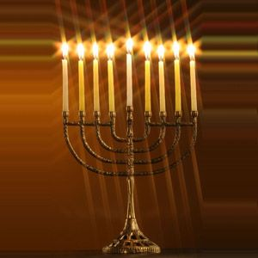
Hannukah: The 9 Pointed Menorah
8 candles celebrate the 8 nights after the temple was liberated by the Maccabees (There was only enough oil for one night!)
Dec. 08—16 2012.

Slide 30
Roman Conquest
64 B.C. Jews lose their independence again
Jews pray for a “Messiah” to free them from Roman rule. (Yeshua of Nazareth is crucified c. 29.A.D.)
In 66 A.D. full scale rebellion against Rome
In 70.A.D., the rebellion is crushed, the temple is destroyed, Jerusalem is sacked, Jews are marched into Rome as slaves
With no more temple sacrifice, Judaism becomes focused on “Synagogues” and “Rabbis”

Slide 31
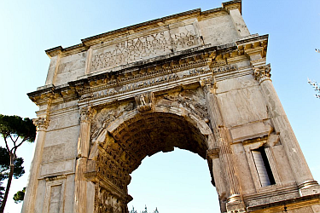
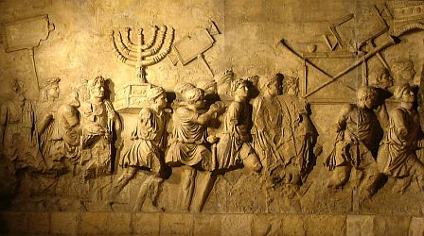
The Arch of Titus
Roman “Arch of Titus” showing the temple treasure and Jewish captives.

Slide 32
Beliefs About God
The universe is governed by God
God is indivisible
Not a physical being
The bible calls God, YHWH (“I am”)
A.K.A. The Lord (“Adonay”)
Handout – “Jewish Beliefs Notes”

Slide 33
The Torah
Contained in a Holy Ark
Usually 2 or 3 in a synagogue
Written on parchment scrolls
Cannot be touched
Taken out during services and read
Divided into 54 sections. One section is read each week for the year

Slide 34
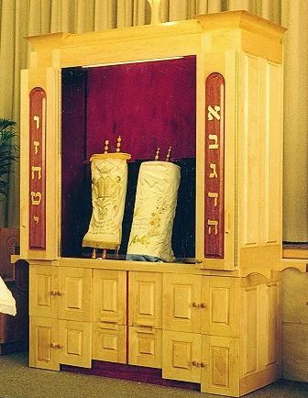
The Torah
Ark doors opened.

Slide 35
Rabbis
A trained scholar, teacher, interpreter of Jewish law, councillor.
Jesus was called Rabbi by his followers
Conduct services like Bar Mitzvahs, weddings, and funerals

Slide 36
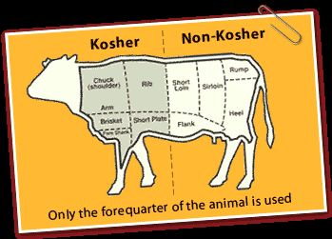
Keeping Kosher: Kashruth
Foods must be prepared according to a set of rules
Out: Pork, rabbit, eagle, owl, catfish, sturgeon, and any shellfish, insect or reptile are non-kosher
Strangled meats are non-kosher
Handout – “Soul Food”

Slide 37
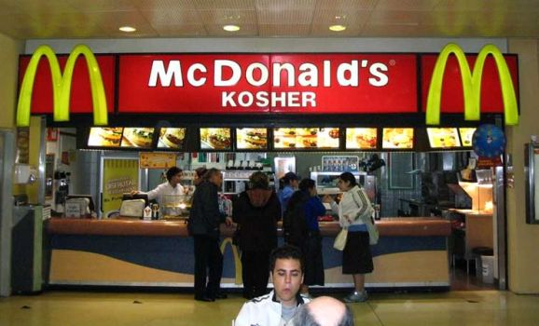
Keeping Kosher

Slide 38
Task
“Soul Food” Questions

Slide 39
Shabbat
Sunset Friday to Sunset Saturday
Go to Synagogue for Friday prayers
Candles lit to remember creation
Shabbas: Sabbath meal
Kiddush: Prayer over the wine
Challah: Egg bread
Shabbat meal in Israel (6:34)

Slide 40
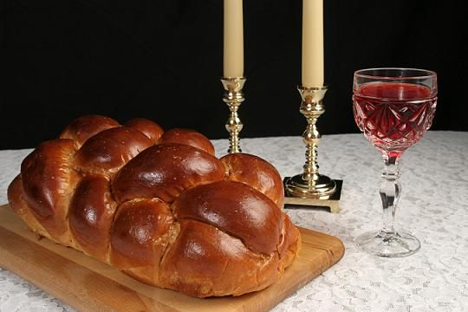
Wine and Challah

Slide 41
Jewish Festivals: Rosh Hashanah
Jewish New Year
Occurs around the Autumn Equinox
Ten day period of repentance
Ends with Yom Kippur: The Day of Atonement
The Shofar is sounded

Slide 42
Videos
How to Blow the Shofar (1:47)
How to celebrate Rosh Hashanah (2:16)
CBN The Feast of The New Year (5:43)

Slide 43
Jewish Festivals: Yom Kippur
Holiest day in the Jewish Year. Fasting, prayers, abstinence. Day of Atonement for sins
Temple sanctuary (1:27) when Hebrews were still a wandering people 1250-1050 BCE
950 BCE-70CE: The High Priest used to enter the Holy of Holies on this day to pray for the sins of the Israelites
Animals were sacrificed for the sins of the people
Arthur: Is that Kosher? (11:20)

Slide 44
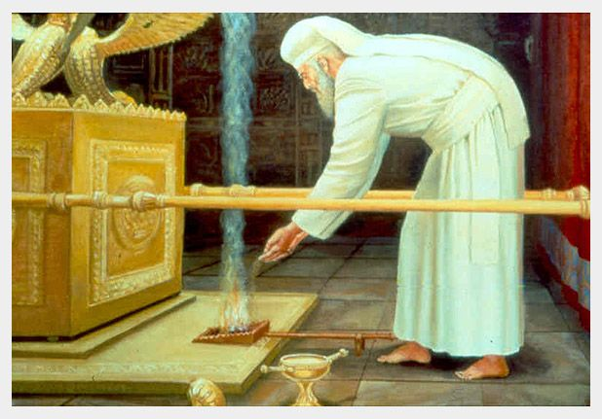
The Kohen Badol on Yom Kippur

Slide 45
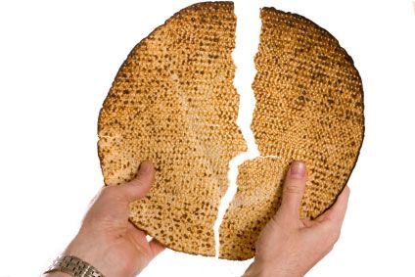
Pesach/Passover: Matzoh
Celebrates the Exodus
No leavened food for a week
Eldest son should fast on the first day
The Sedar: Ritual service and dinner held at home on first night of Passover

Slide 46
Passover Seder
Events of the Exodus are retold
How to Host a Passover Seder (5:17)
Learning about Passover with Rabbi Akselrad (4:14)

Slide 47
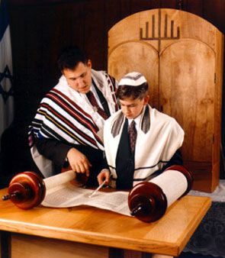
Bar/Bat Mitzvah
Coming of age ceremony at 13
Noam’s Bar Mitzvah (9:53)
Bat Mitzvah at Boston Temple (5:11)

Slide 48
Weddings
Take place under a canopy called a Chuppah
Drink from a glass of wine
Crush a glass under foot
Orthodox Jewish wedding Brooklyn NY 2005 (6:12)
Handout – “Jewish Sacred Witings”

Slide 49
Death
Cremation is not allowed
Burial within 24 hours if possible (like Islam)
Shiva: a seven day period of mourning
Mourners stay at home
Mirrors are covered
How to sit Shiva (2:26)
Handout – “Jewish Feasts and Celebrations”

Slide 50
Types of Judaism
Orthodox / Hasidic
Reform
Conservative
Reconstructionist

Slide 51
Zionism
Return of Jews to the Promised Land
Began in 1896 with Theodore Herzl
After the Holocaust, the state of Israel was declared in 1948
Conflict has been ongoing. . .

